Slide 1
Mapping VO-DML data models to TABLEs
Prototypes

Slide 2

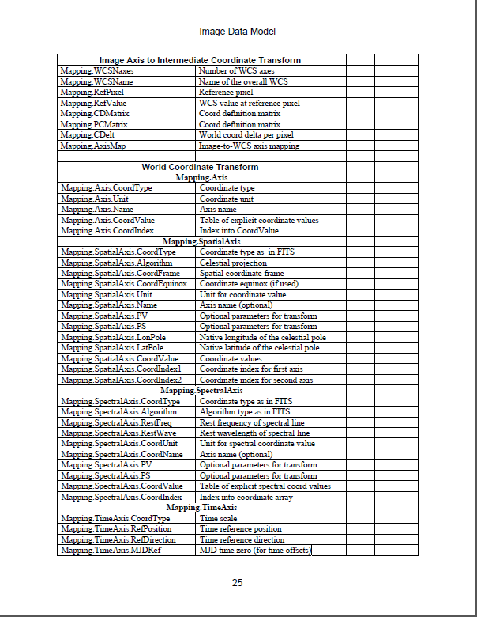
This is NOT a data model

Slide 3
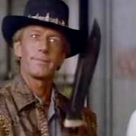
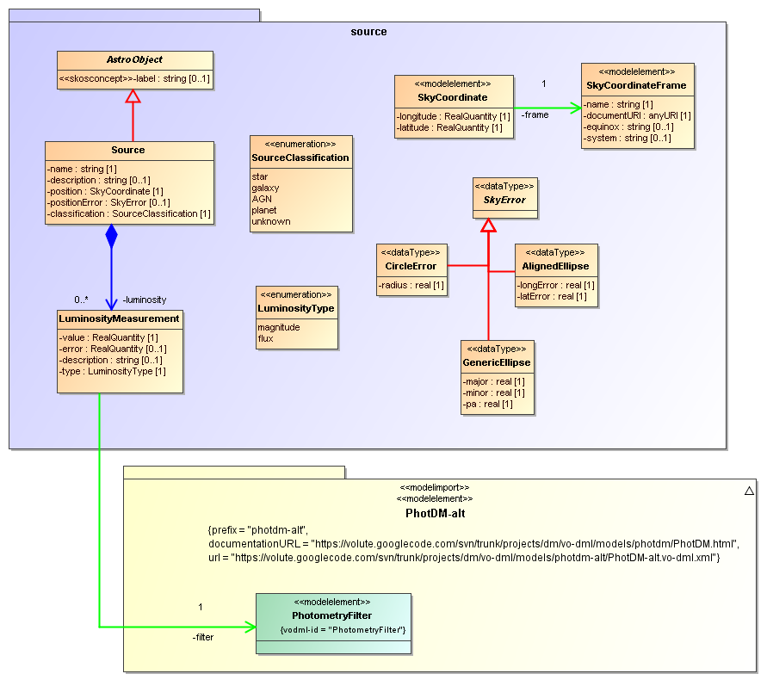
This is a data model (a simple on)
( https://volute.googlecode.com/svn/trunk/projects/dm/vo-dml/models/source )

Slide 4
VO-DML
Models can be complex
graphs, not trees, definitely not lists
relationships can be one-to-many, many-to-one, many-many
VERY advantageous to have a common language
supporting comparison, reuse
machine readable
standard processing tools
standard serialisation, mapping etc etc
VO-DML is such a language
VO-UML
VO-DML/XML
VO-DML/I

Slide 5
Prototypes for VO-DML
IVOA models have been ported to VO-DML, some explicitly reusing others.
see <volute>/vo-dml/models
MUST be worked on
ant target ‘validate_vo-dml’ for validating VO-DML/XML documents
see <volute>/vo-dml/build.xml
XSLT script written to generate HTML, Java form these
See <volute>/vo-dml/xslt
run from same ant fscript
VO-URP also XSD, RDB+TAP schemas; web application using the VO-DML representation.
XSLT scripts have been written generating VO-DML from XMI
for MAgicDraw CE 12.1: ant run_xmi2vo-dml

Slide 6
Prototypes for UTYPE mapping: VO-DML Mapper
web app for mapping models to tables
http://gavo.mpa-garching.mpg.de/dev/vodml-mapper/
allows importing VO-DML data models
allows importing TABLES
from TAP_SCHEMAs
from VOTable-s
from VizieR
Allows drag-and-drop linking of VO-DML components to TABLEs and COLUMNs
Can generate a VOTable describing the mapping of the tables.

Slide 7
Prototypes for UTYPE mapping: Java based validator and interpreter
Given a VO-DML-annotated VOTable:
validates annotation based on VO-DML models
interprets annotation
Validation:
import the declared models (and any models down-stream)
check whether declared utypes exist in a VO-DML model
check whether (annotated) components of annotated GROUPs are compatible with annotation of parent
Interpretation:
infer from VOTable which Java objects can be inferred
Use generated Java classes
instantiate collections of objects of proper type, filled with contents (attributes, collections etc).
Create default serialization (VO-DML/I)
See <volute>/vo-dml/java
src: org.ivoa.vodml.mapping.VOTableInterpreter

Slide 8
Possible prototype effort (Laurent ?)
Annotate specific VizieR tables with source data model
NB requires sophisticated source data model
VO-DML Mapper can help?
Create X-match model
using Source model
From tool that can query VizieR tables
interpret results using Source model
would be nice if VizieR returned properly annotated result!
Match collections of Sources
i.e. “code against the DM, not the tables!)
Produces CrossIdentification objects from X-Match
This makes final step:
coding against a global model rather than against serializations

Slide 9
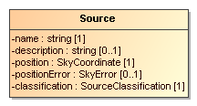
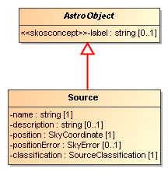
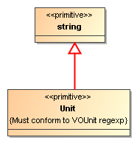


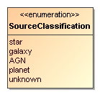
VO-DML/VO-UML: Types
VO-DML: ObjectType
UML: Classifier
VO-DML: DataType
UML: DataType
VO-DML: PrimitiveType
UML: PrimitiveType
VO-DML: Extends, inheritance
UML: generalization
VO-DML: Enumeration
UML: Enumeration

Slide 10
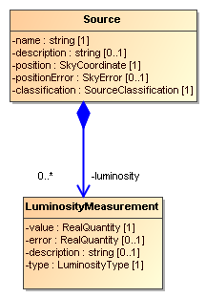
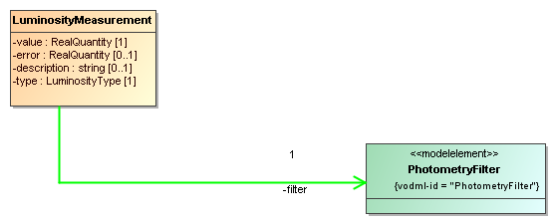
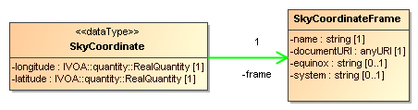
VO-DML/VO-UML: Roles and Relationships
VO-DML: Attribute,
Role a ValueType plays in definition of
an ObjectType or DataType
UML: Property of ValueType
Collection, between ObjectType-s
UML: composition relationship
Reference
UML: shared, navigable binary association
Reference, also from DataType → ObjectType

Slide 11
Data Models describe Instances
VO-DML Model describes VO-DML instances.
Instances of VO-DML types
ObjectType → Object
ValueType → Value
Attribute →
Relationships between types → relations between objects
Collection → Containment
Reference → “Pointer”
Extends → Inheritance of properties (no relation between objects!)

Slide 12
Mapping
Representing VO-DML instances in other meta-model
Tables
XML
Java (in-memory)
Serialization
Mapping = Linking/annotating serializations to identify model element they represent
In UTYPE proposal such mapping is proposed for VOTable

Slide 13
Visual mapping: VO-DML → (VO)Table(s)
Represent instances and relationships visually
Use UTYPEs to identify VO-DML types and roles
Represent Table(s) visually
Link VO-DML instances to Tables
drawing lines between compatible components
Translate to UTYPE based annotation
Implemented in VO-DML Mapper
http://gavo.mpa-garching.mpg.de/dev/vodml-mapper/

Slide 14
Mapper elements
PrimitiveType
ObjectType
DataType
Enumeration
Table

Slide 15
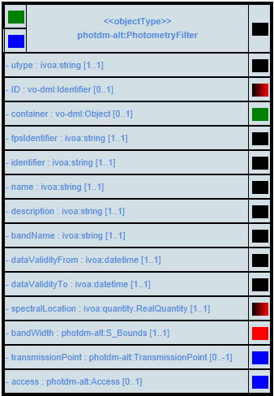
Instance of ObjectType, i.e. Object
Header indicates vo-dml “meta-type” and utype
Rows contain name, data type, multiplicity of VO-DML role, possibly inherited from base class
Connectors explained later

Slide 16


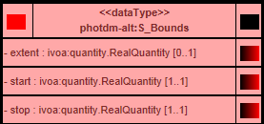
Similar for Instance of Value Types i.e. Values
PrimitiveType
Enumeration
DataType
From now on only schematic, no labels

Slide 17
Connectors used in visual mapping
On roles, outgoing, on right
Attribute of PrimitiveType or Enumeration or (in header) link to TABLE
Attribute of (structured) DataType
Attribute of DataType that MAY be mapped dirctly to FIELD/PARAM
e.g. from ivoa:/quantity/***
Reference
Collection
In Header
Outgoing: explicit connection instance → table
Incoming reference
Incoming Collection
Incoming Attribute link

Slide 18
TABLE
Grey: header with incoming connector to indicate an object is stored in each row
White: column (FIELD) with incoming connector for (simple) attributes
Yellow: PARAM with incoming connector for (simple) attributes

Slide 19
Visual mapping
Link outgoing to compatible incoming connectors:
right color (note “gradient black-red”)
structured VO-DML type → TABLE
VO-DML Attribute → FIELD or PARAM
VO-DML Attribute → VO-DML DataType
VO-DML Attribute → VO-DML PrimitiveType or Enumeration (constant value)
VO-DML Reference → VO-DML ObjectType (or vo-dml:Reference for ORM)
VO-DML Collection → VO-DML ObjectType

Slide 20
Mapping annotates serialized objects
Objects can be serialized
in row in TABLE
in GROUP
Mixture: Object in GROUP+TABLE
possible even if NO FIELDref-s!
GROUP in TABLE always implies object in TR? Even if no FIELDref?
Other GROUP in separate mapping RESOURCE (with utype indicating root collection of objects)
?? Object in multiple tables?
inheritance mapping (standard Object-Relational Mapping pattern)
legacy mapping (objects happens to be stored in different tables)
Following slides show various patterns, with [TBD!!] indication how to represent them using UTYPE-s and GROUPS etc

Slide 21
Singleton Object
No link to TABLE
HHH
BBB

Slide 22
UTYPE annotation
“GROUP-as-Instance”, “Singleton-GROUP”
GROUP utype=

Slide 23
Objects in TABLE
Explicit, link from type to table
Implicit, link from component attribute(s)
to table

Slide 24
Objects in TABLE
Implicit and indirect, via DataType attribute, which links to table

Slide 25
Relatively straightforward
All relations can be made using
collections in GROUPs-as-instance
references using “GROUPref”
embedding collection elemnt(s) in same row (flattening)
shared reference to GROUPs-as-instance (GROUPref) for all elements in table

Slide 26
an “object-in GROUP” refers to other “object-in-GROUP”

Slide 27
all objects in TABLE refer to same object in GROUP

Slide 28
each row in TABLE contains both source and target objects of reference (using GROUPref, NO FK)

Slide 29
object in GROUP contains another object in GROUP

Slide 30
object-in-GROUP contains multiple objects-in-GROUP

Slide 31
each row in TABLE contains both parent and child object of collection (“flattening”)

Slide 32
each row in TABLE contains both parent and multiple child objects of collection (“flattening”)

Slide 33
all objects in table are contained by same parent(-in-GROUP)

Slide 34
more complex: “referencing per ID” ala Object Relational Mapping (ORM)
objects (in tables) referencing each other via FKs
inverting relation between parent and child in collection
Need referenced object to define an Identifier explicitly
Need referring object to define a FK implementing the reference
also objects from table referencing objects in GROUP-s if NOT all rows refer to same object.
Note, in latter case, iso defining the GROUPs, maybe users should put those objects in a table?, i.e. only have referencing-per-id between tables?

Slide 35
ID
vo-dml:Identifier
- field [1..*]
vo-dml:Identifier
- field [1..*]
vo-dml:Identifier
- field [1..*]

Slide 36
Assigning identifier.
vo-dml:Identifier
- field [1..*]
- ID: vo-dml:Identifier [0..1]
ID attribute inherited from vo-dml:ObjectType

Slide 37
Default case (single field)
- ID: vo-dml:Identifier [0..1]
==
vo-dml:Identifier
- field [1..*]
- ID: vo-dml:Identifier [0..1]

Slide 38
Default case (single field)
- ID: vo-dml:Identifier [0..1]
==
vo-dml:Reference
- field [1..*]
- ID: vo-dml:Identifier [0..1]

Slide 39
Object in 1 TABLE references object in another table (or other row in same TABLE)

Slide 40
Object in 1 TABLE contains objects in another table (never (?) in other rows in same TABLE)

Slide 41
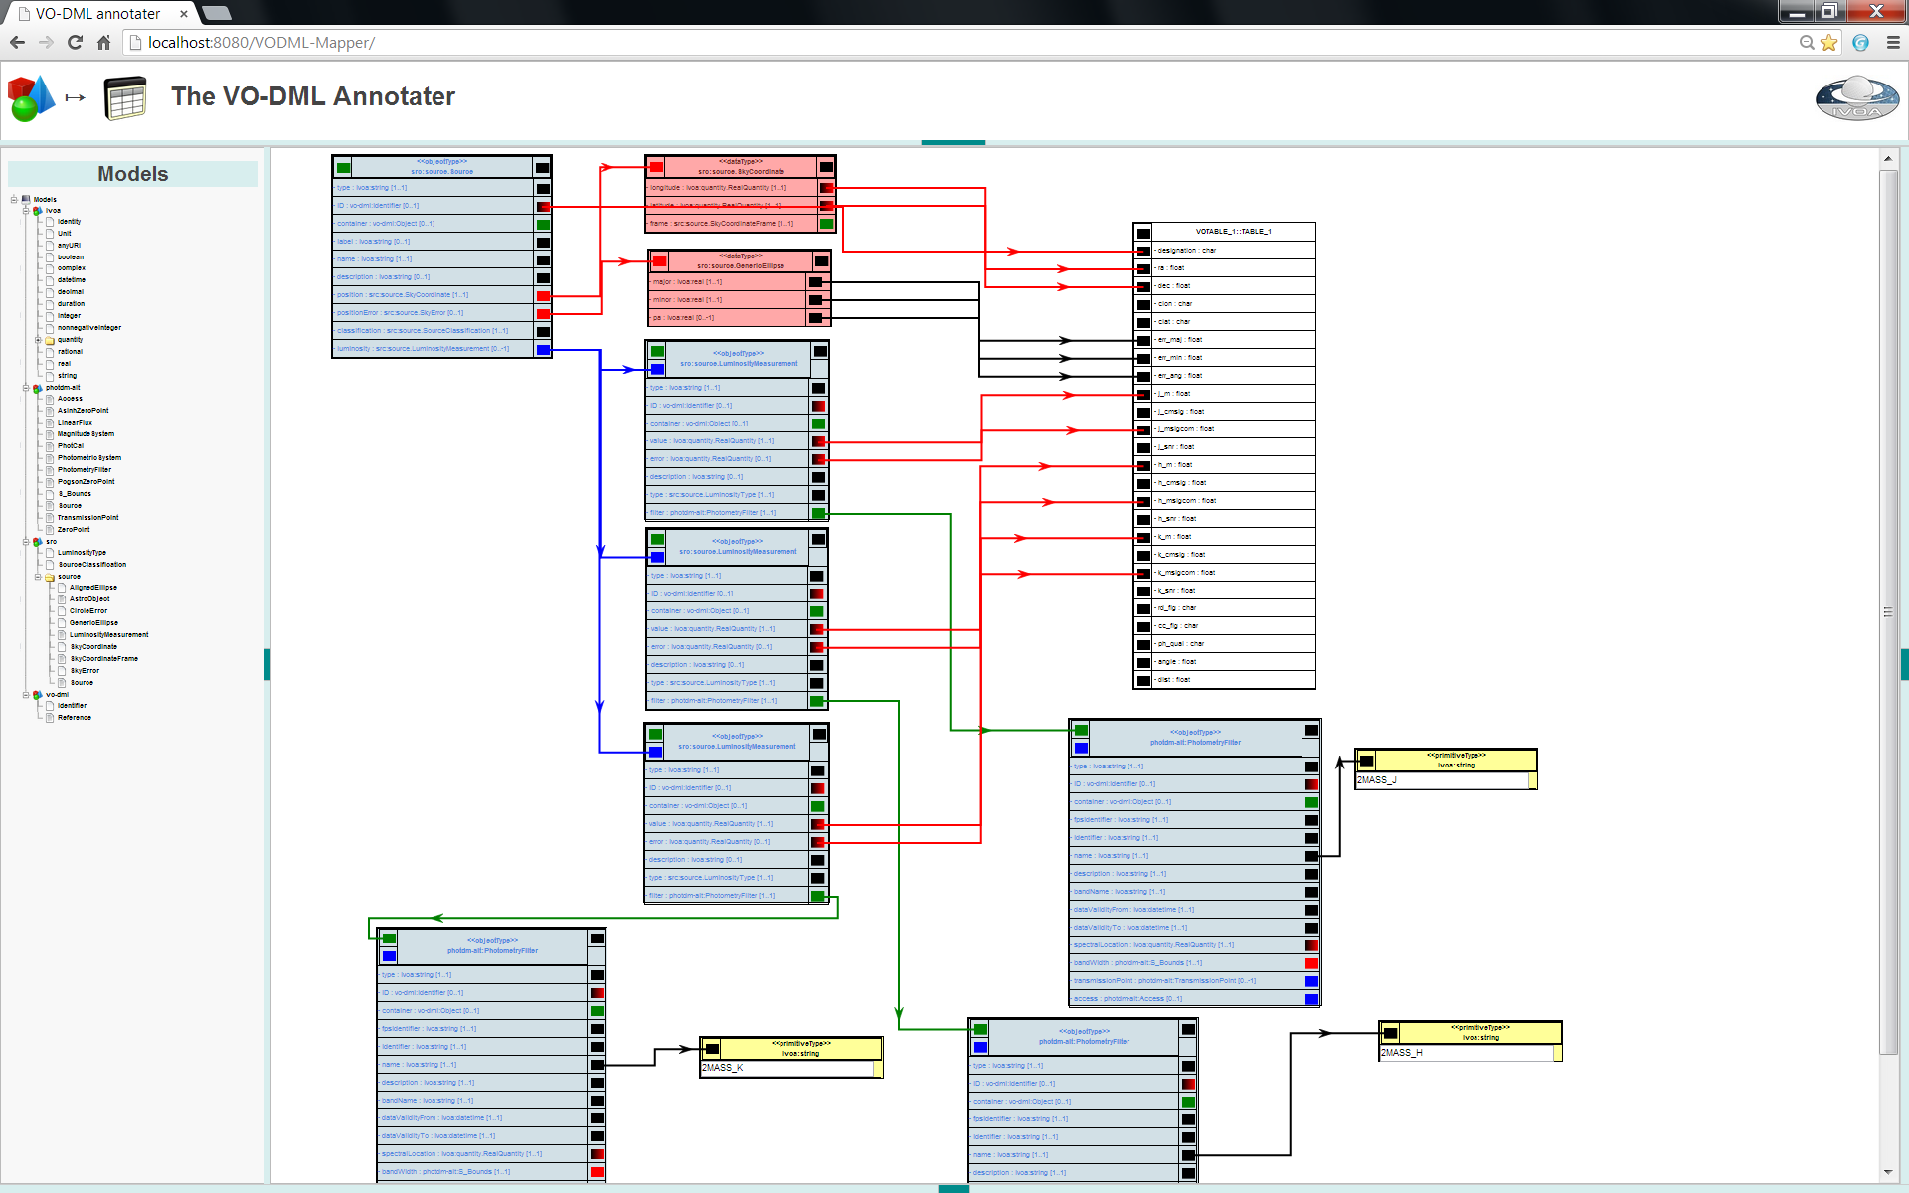

Slide 42
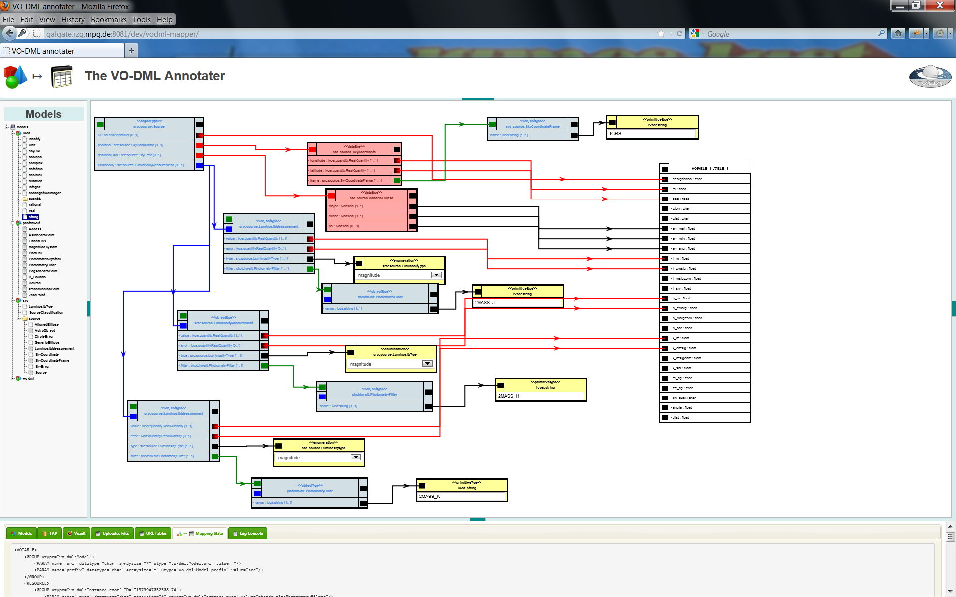

Slide 43
<VOTABLE>
<GROUP utype="vo-dml:Model">
<PARAM name="url" datatype="char" arraysize="*" utype="vo-dml:Model.url" value="http://volute.googlecode.com/svn/trunk/projects/dm/vo-dml/models/ivoa/IVOA.vo-dml.xml"/>
<PARAM name="prefix" datatype="char" arraysize="*" utype="vo-dml:Model.prefix" value="ivoa"/>
</GROUP>
<GROUP utype="vo-dml:Model">
<PARAM name="url" datatype="char" arraysize="*" utype="vo-dml:Model.url" value="http://localhost:8080/VODML-Mapper/vo-dml/VO-DML.vo-dml.xml"/>
<PARAM name="prefix" datatype="char" arraysize="*" utype="vo-dml:Model.prefix" value="vo-dml"/>
</GROUP>
<GROUP utype="vo-dml:Model">
<PARAM name="url" datatype="char" arraysize="*" utype="vo-dml:Model.url" value="https://volute.googlecode.com/svn/trunk/projects/dm/vo-dml/models/photdm-alt/PhotDM-alt.vo-dml.xml"/>
<PARAM name="prefix" datatype="char" arraysize="*" utype="vo-dml:Model.prefix" value="photdm-alt"/>
</GROUP>
<GROUP utype="vo-dml:Model">
<PARAM name="url" datatype="char" arraysize="*" utype="vo-dml:Model.url" value="http://localhost:8080/VODML-Mapper/vo-dml/SourceDM.vo-dml.xml"/>
<PARAM name="prefix" datatype="char" arraysize="*" utype="vo-dml:Model.prefix" value="src"/>
</GROUP>
<RESOURCE>
<GROUP utype="vo-dml:Instance.root" ID="T1378301495159_70">
<PARAM name="_type" datatype="char" arraysize="*" utype="vo-dml:Instance.type" value="photdm-alt:PhotometryFilter"/>
<PARAM name="undefined" datatype="char" arraysize="*" utype="photdm-alt:PhotometryFilter.name" value="2MASS_J"/>
</GROUP>
<GROUP utype="vo-dml:Instance.root" ID="T1378301495159_90">
<PARAM name="_type" datatype="char" arraysize="*" utype="vo-dml:Instance.type" value="photdm-alt:PhotometryFilter"/>
<PARAM name="undefined" datatype="char" arraysize="*" utype="photdm-alt:PhotometryFilter.name" value="2MASS_H"/>
</GROUP>
<GROUP utype="vo-dml:Instance.root" ID="T1378301495159_136">
<PARAM name="_type" datatype="char" arraysize="*" utype="vo-dml:Instance.type" value="photdm-alt:PhotometryFilter"/>
<PARAM name="undefined" datatype="char" arraysize="*" utype="photdm-alt:PhotometryFilter.name" value="2MASS_K"/>
</GROUP>
</RESOURCE>
<RESOURCE>
<TABLE ID="T1378301495159_19">
<GROUP utype="vo-dml:Instance.root" ID="T1378301495159_6">
<PARAM name="_type" datatype="char" arraysize="*" utype="vo-dml:Instance.type" value="src:source.Source"/>
<GROUP utype="src:source.Source.position" ID="T1378301495159_46">
<PARAM name="_type" datatype="char" arraysize="*" utype="vo-dml:Instance.type" value="src:source.SkyCoordinate"/>
<FIELDref ref="T1378301495159_19_F1" utype="src:source.SkyCoordinate.longitude"/>
<FIELDref ref="T1378301495159_19_F2" utype="src:source.SkyCoordinate.latitude"/>
</GROUP>
<GROUP utype="src:source.Source.positionError" ID="T1378301495159_52">
<PARAM name="_type" datatype="char" arraysize="*" utype="vo-dml:Instance.type" value="src:source.GenericEllipse"/>
<FIELDref ref="T1378301495159_19_F5" utype="src:source.GenericEllipse.major"/>
<FIELDref ref="T1378301495159_19_F6" utype="src:source.GenericEllipse.minor"/>
<FIELDref ref="T1378301495159_19_F7" utype="src:source.GenericEllipse.pa"/>
</GROUP>
<FIELDref ref="T1378301495159_19_F0" utype="vo-dml:Object.ID"/>
<GROUP utype="src:source.Source.luminosity" ID="T1378301495159_58">
<PARAM name="_type" datatype="char" arraysize="*" utype="vo-dml:Instance.type" value="src:source.LuminosityMeasurement"/>
<FIELDref ref="T1378301495159_19_F8" utype="src:source.LuminosityMeasurement.value"/>
<FIELDref ref="T1378301495159_19_F10" utype="src:source.LuminosityMeasurement.error"/>
<GROUP utype="src:source.LuminosityMeasurement.filter" ref="T1378301495159_70"/></GROUP>

Slide 44
<PARAM name="_type" datatype="char" arraysize="*" utype="vo-dml:Instance.type" value="src:source.LuminosityMeasurement"/>
<GROUP utype="src:source.LuminosityMeasurement.filter" ref="T1378301495159_90"/>
<FIELDref ref="T1378301495159_19_F12" utype="src:source.LuminosityMeasurement.value"/>
<FIELDref ref="T1378301495159_19_F14" utype="src:source.LuminosityMeasurement.error"/>
</GROUP>
<GROUP utype="src:source.Source.luminosity" ID="T1378301495159_124">
<PARAM name="_type" datatype="char" arraysize="*" utype="vo-dml:Instance.type" value="src:source.LuminosityMeasurement"/>
<GROUP utype="src:source.LuminosityMeasurement.filter" ref="T1378301495159_136"/>
<FIELDref ref="T1378301495159_19_F16" utype="src:source.LuminosityMeasurement.value"/>
<FIELDref ref="T1378301495159_19_F18" utype="src:source.LuminosityMeasurement.error"/>
</GROUP>
</GROUP>
<INFO name="type" value="VOTABLE"/>
<INFO name="votable_url" value="UPLOAD:2mass.votable"/>
<INFO name="table_rank" value="1"/>
<INFO name="ID" value="_2MASS"/>
<FIELD name="designation" datatype="char" arraysize="*" xtype="null" ID="T1378301495159_19_F0"/>
<FIELD name="ra" datatype="float" xtype="null" ID="T1378301495159_19_F1"/>
<FIELD name="dec" datatype="float" xtype="null" ID="T1378301495159_19_F2"/>
<FIELD name="clon" datatype="char" arraysize="*" xtype="null" ID="T1378301495159_19_F3"/>
<FIELD name="clat" datatype="char" arraysize="*" xtype="null" ID="T1378301495159_19_F4"/>
<FIELD name="err_maj" datatype="float" xtype="null" ID="T1378301495159_19_F5"/>
<FIELD name="err_min" datatype="float" xtype="null" ID="T1378301495159_19_F6"/>
<FIELD name="err_ang" datatype="float" xtype="null" ID="T1378301495159_19_F7"/>
<FIELD name="j_m" datatype="float" xtype="null" ID="T1378301495159_19_F8"/>
<FIELD name="j_cmsig" datatype="float" xtype="null" ID="T1378301495159_19_F9"/>
<FIELD name="j_msigcom" datatype="float" xtype="null" ID="T1378301495159_19_F10"/>
<FIELD name="j_snr" datatype="float" xtype="null" ID="T1378301495159_19_F11"/>
<FIELD name="h_m" datatype="float" xtype="null" ID="T1378301495159_19_F12"/>
<FIELD name="h_cmsig" datatype="float" xtype="null" ID="T1378301495159_19_F13"/>
<FIELD name="h_msigcom" datatype="float" xtype="null" ID="T1378301495159_19_F14"/>
<FIELD name="h_snr" datatype="float" xtype="null" ID="T1378301495159_19_F15"/>
<FIELD name="k_m" datatype="float" xtype="null" ID="T1378301495159_19_F16"/>
<FIELD name="k_cmsig" datatype="float" xtype="null" ID="T1378301495159_19_F17"/>
<FIELD name="k_msigcom" datatype="float" xtype="null" ID="T1378301495159_19_F18"/>
<FIELD name="k_snr" datatype="float" xtype="null" ID="T1378301495159_19_F19"/>
<FIELD name="rd_flg" datatype="char" arraysize="*" xtype="null" ID="T1378301495159_19_F20"/>
<FIELD name="cc_flg" datatype="char" arraysize="*" xtype="null" ID="T1378301495159_19_F21"/>
<FIELD name="ph_qual" datatype="char" arraysize="*" xtype="null" ID="T1378301495159_19_F22"/>
<FIELD name="angle" datatype="float" xtype="null" ID="T1378301495159_19_F23"/>
<FIELD name="dist" datatype="float" xtype="null" ID="T1378301495159_19_F24"/>
</TABLE>
</RESOURCE>
</VOTABLE>

